Slide 1

Global Filters
KPI Fire V4.1

Slide 2
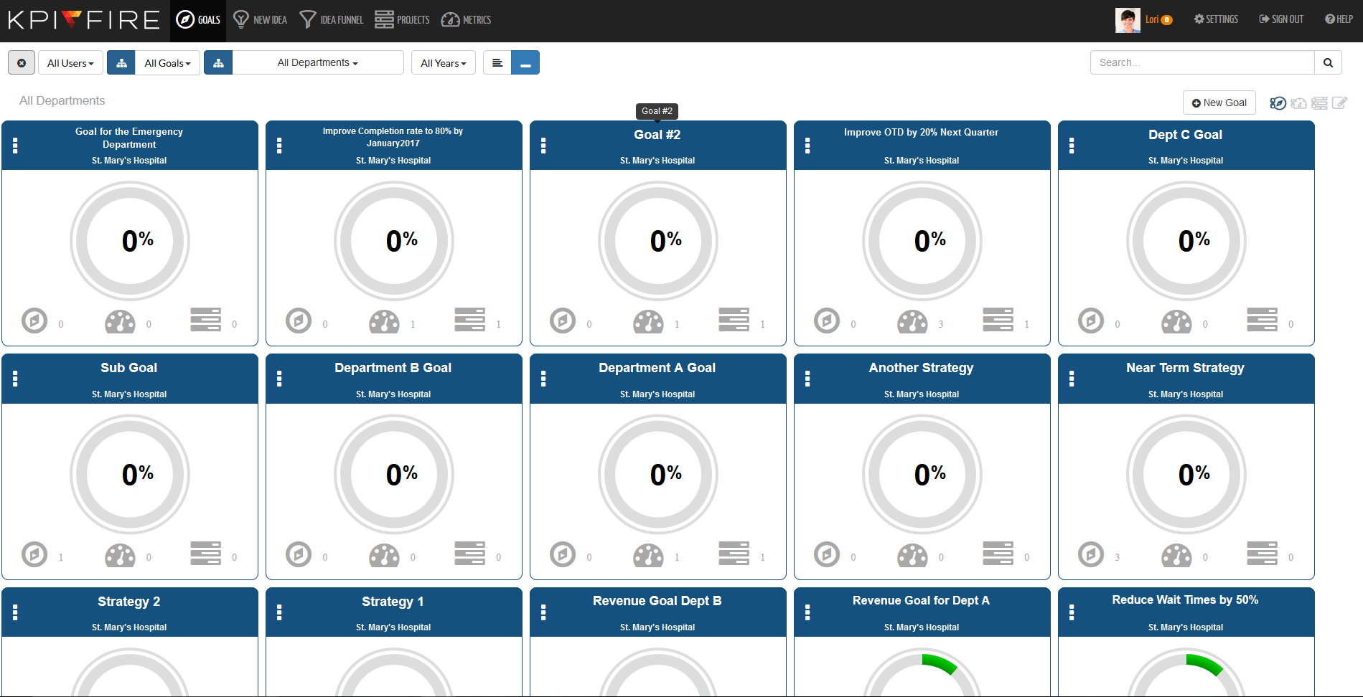
Aim of Global Filters
Designed to help you manage all Goals, Projects and Metrics in KPI Fire

Slide 3
Global Filters
There are four basic filters
  Users
  Goals
  Departments
  Year
You can also edit the display to show tiles in either a flat or hierarchical arrangement.

Slide 4
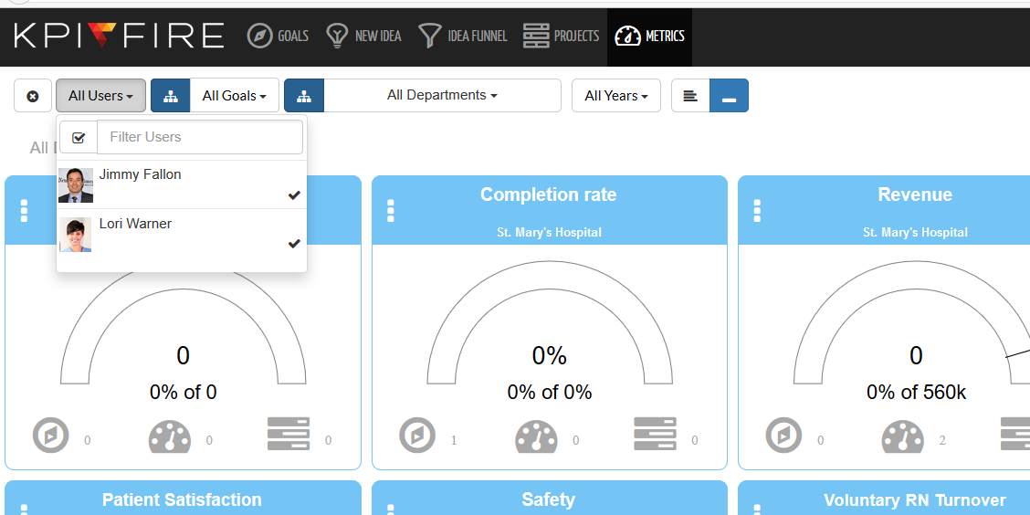
Global Filters Users
Checkbox allows you to filter items by a specific team member

Slide 5
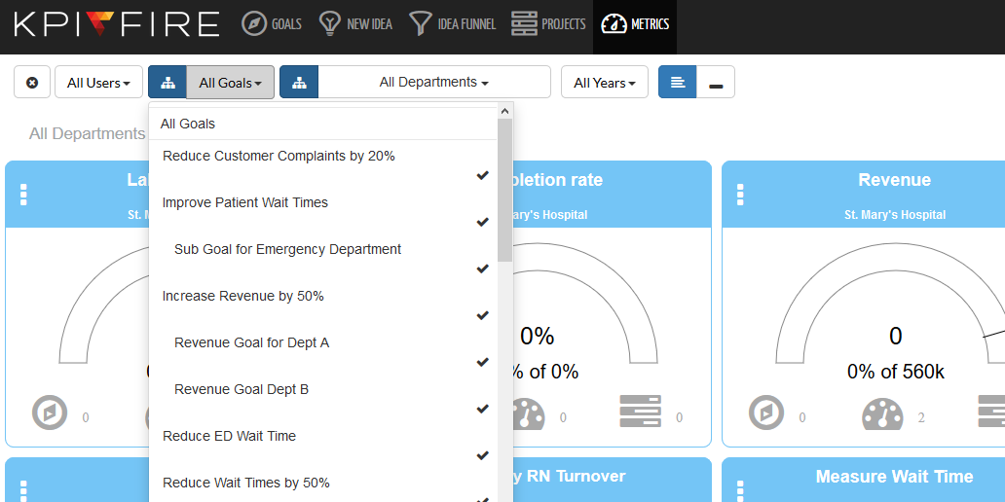
Global Filters Goals
By selecting a goal you can display all of the metrics or projects associated to it

Slide 6
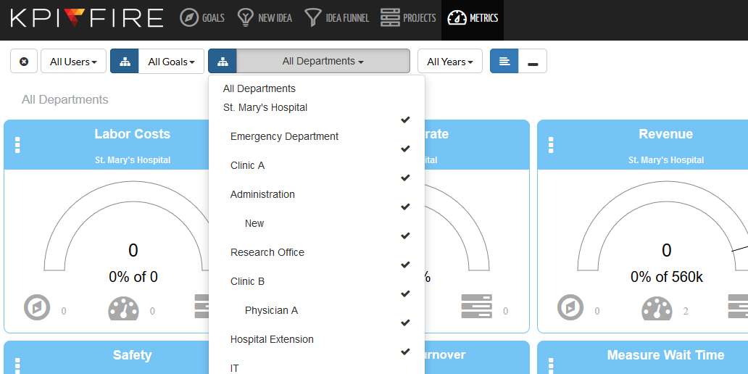
Global Filters Departments
This filter allows you to show metrics, projects and goals for each department

Slide 7
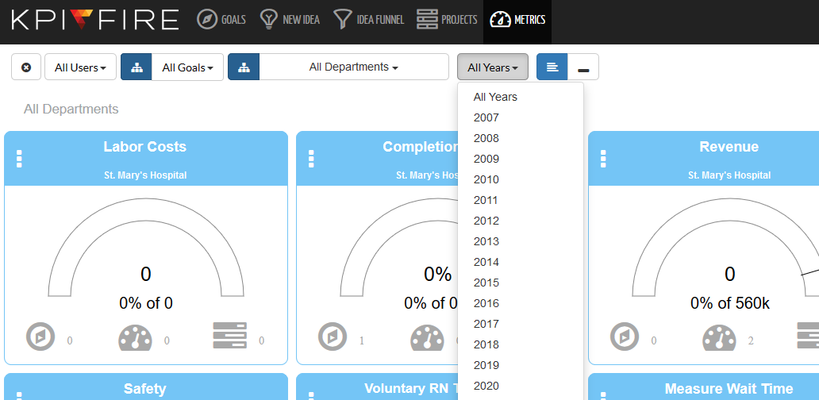
Global Filters Year
For goals and projects active for the year selected the tile will be displayed.
For metrics the tile will display data from the selected year.

Slide 8
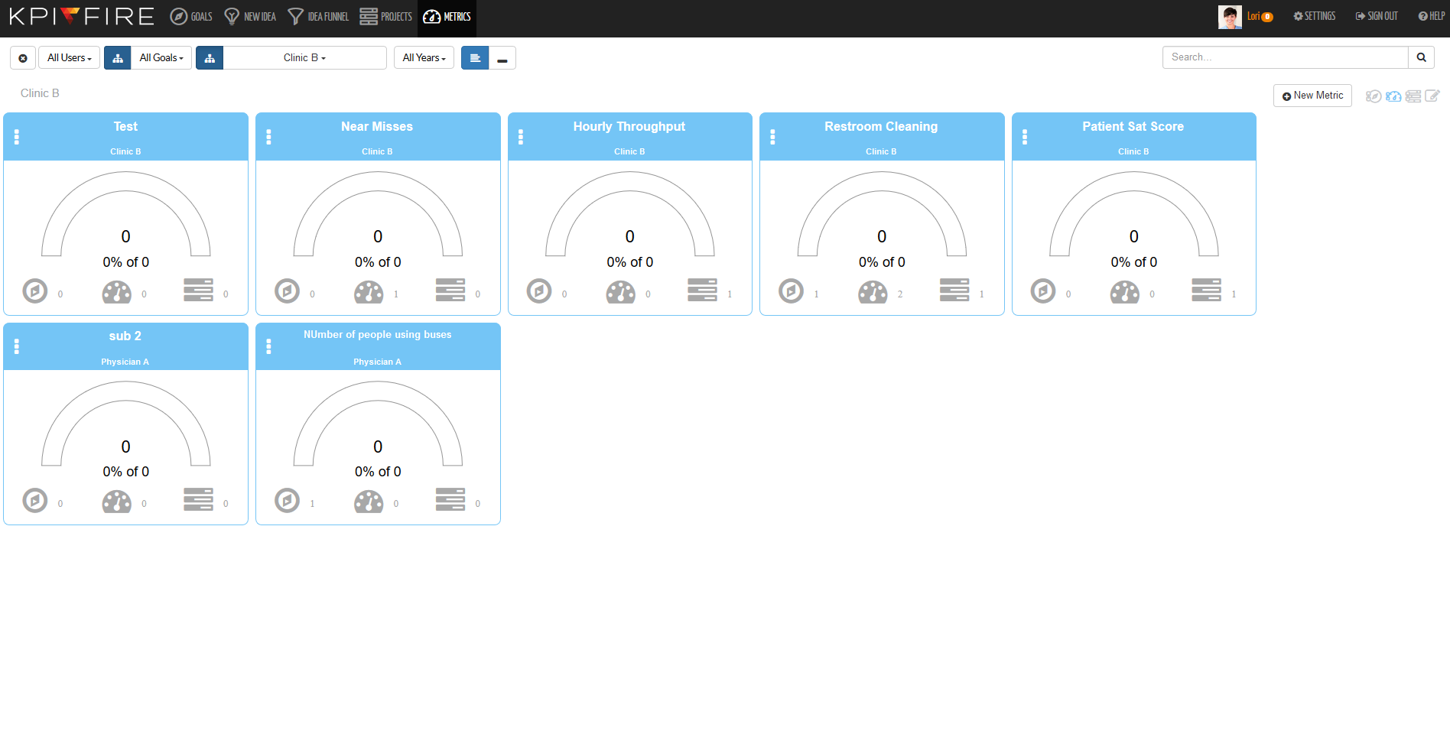
Global Filters Hierarchical vs Flat View
Hierarchical view shows only the parent metrics

Slide 9
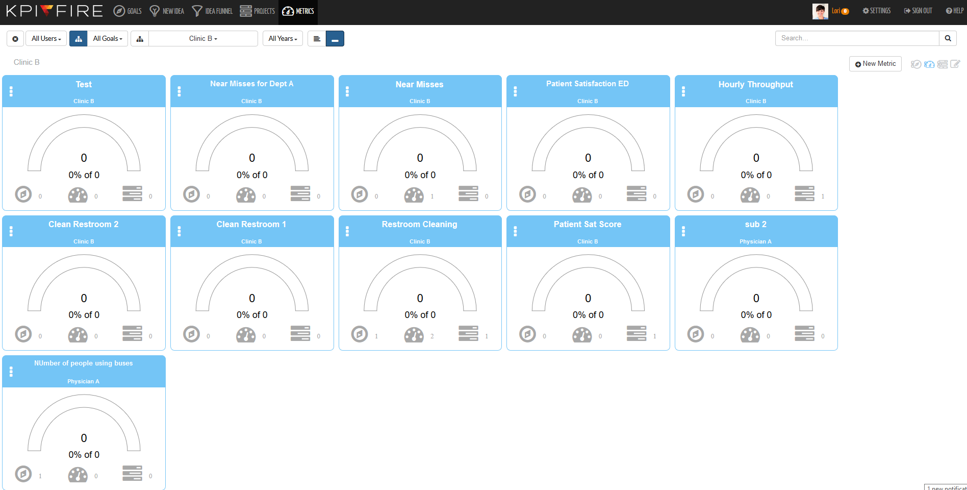
Global Filters Hierarchical vs Flat View
Flat view will also shows the child metrics as well

