Slide 1

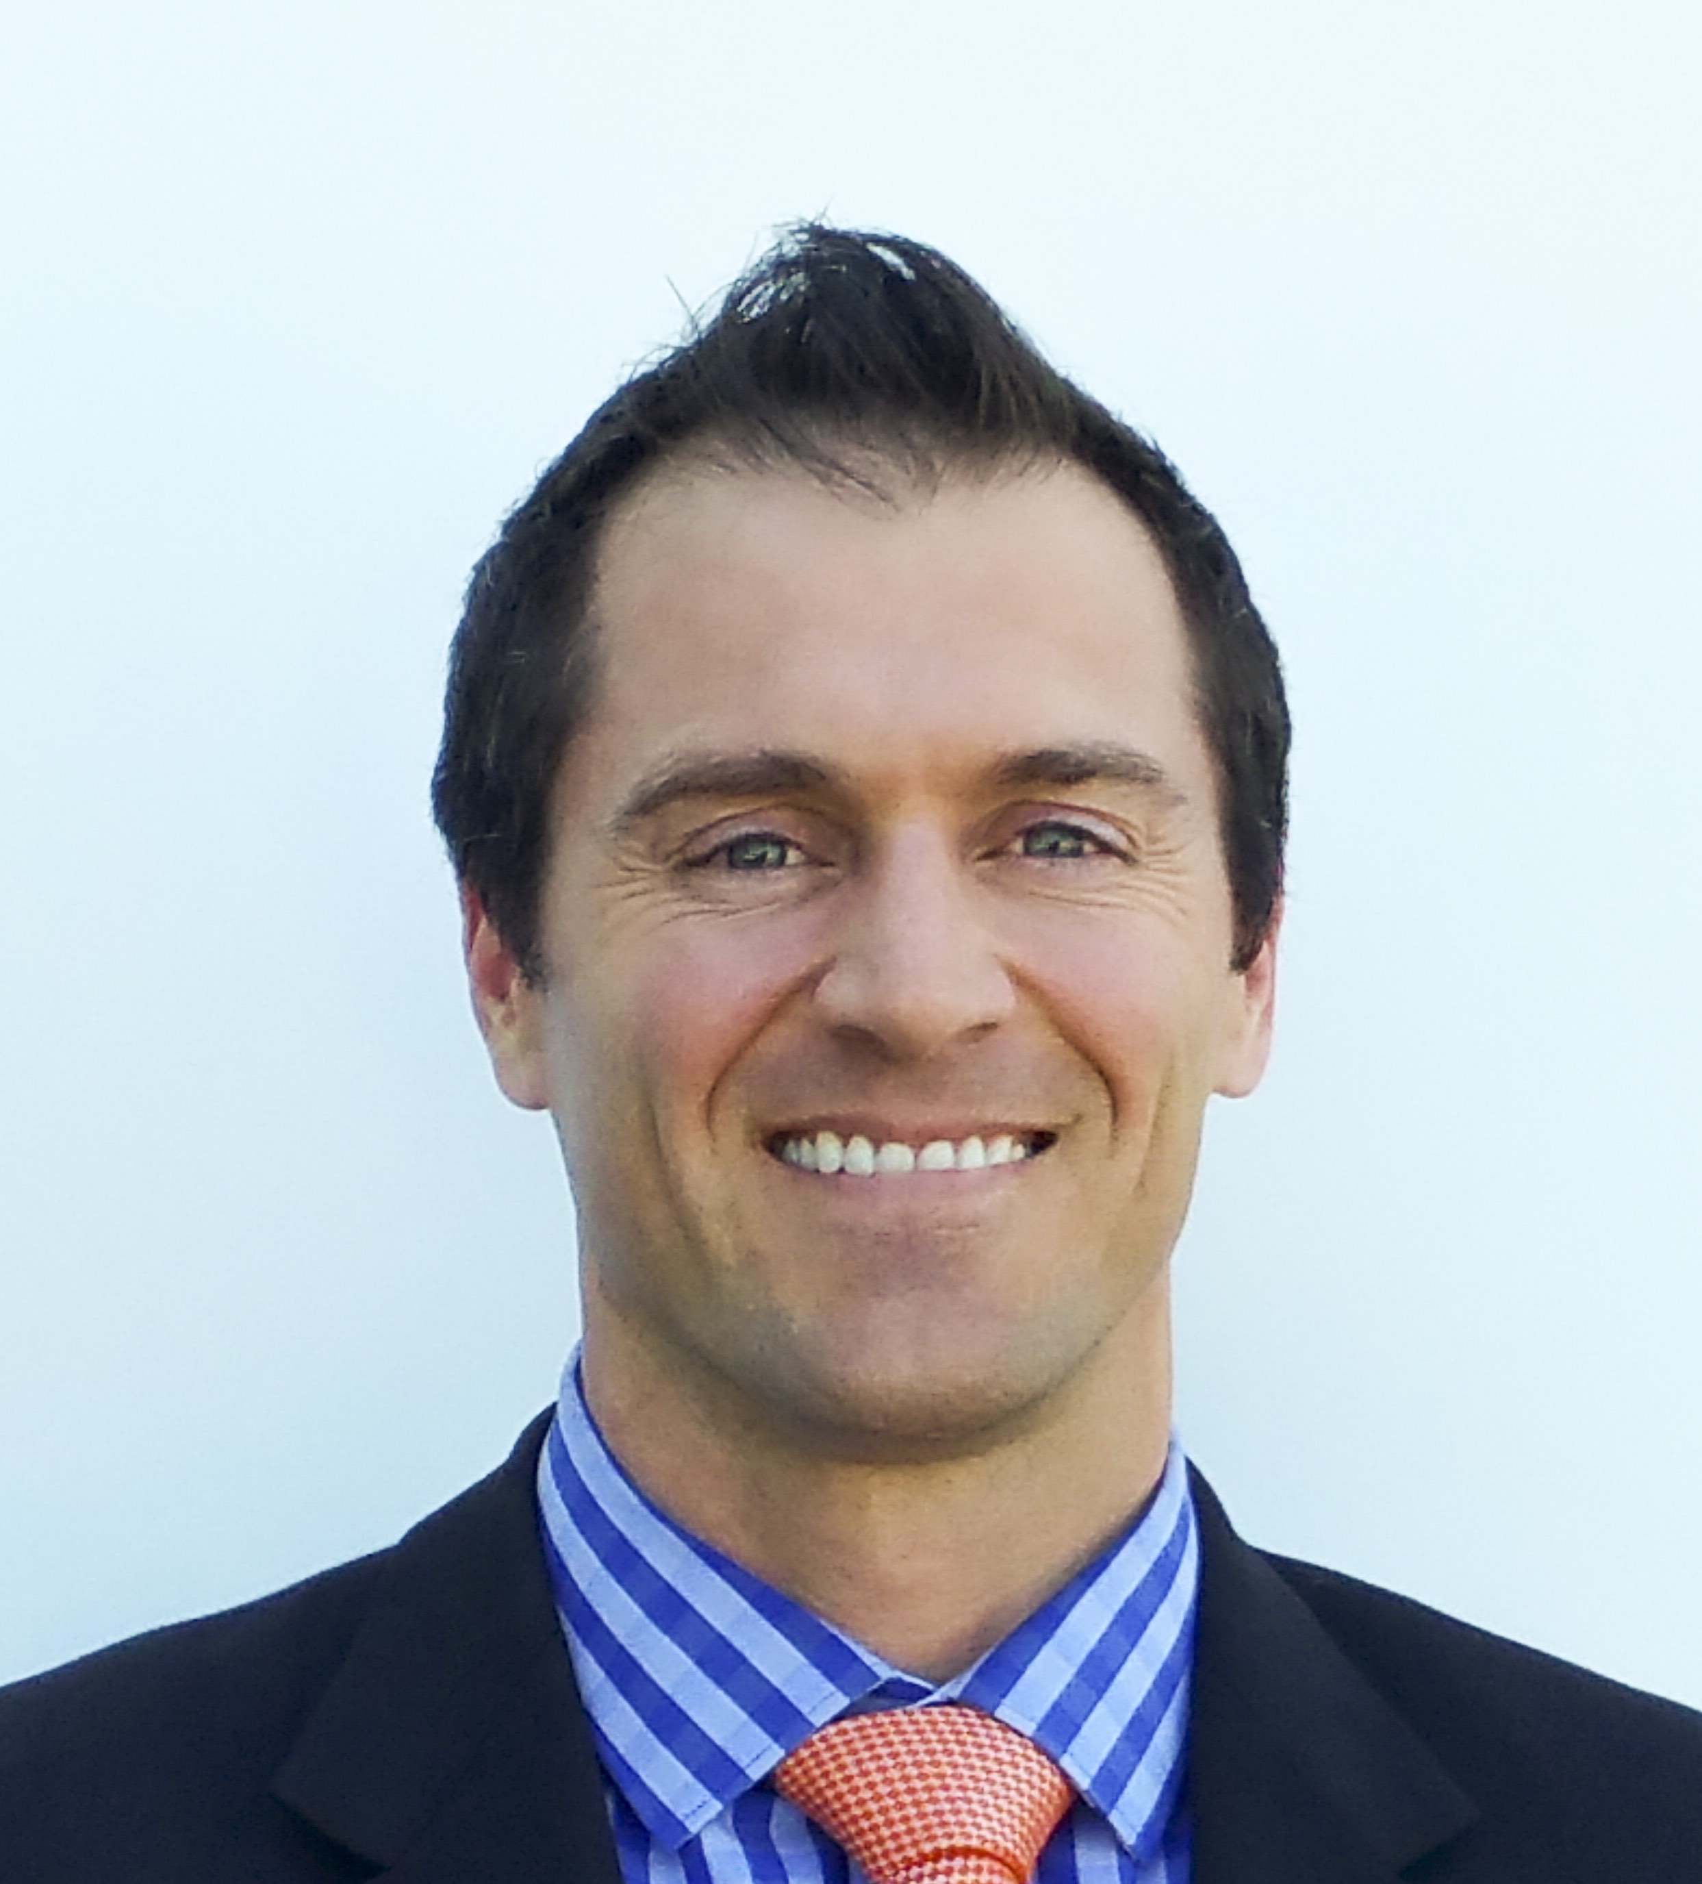


Managing Projects in KPI Fire
2021

→
Keith Norris
keith.norris@kpifire.com
1-801-456-8170
Salt Lake City, USA UTC-6

Slide 2
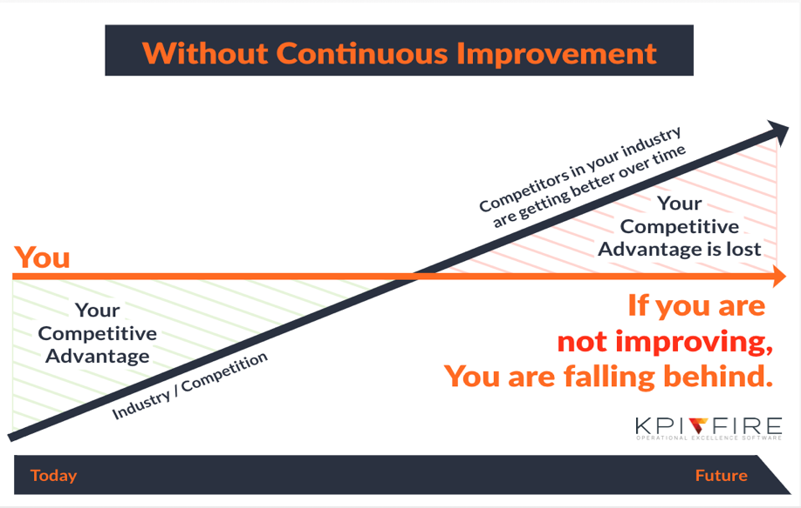
Notes:
Competitors don’t stop improving when you stop improving. Which is why companies must constantly strive to improve their business in order to stand up against competition and maintain competitive advantage.
“If you are not improving, you are falling behind.”
Additional Resources:
https://keithcnorris.medium.com/continuous-improvement-program-best-practices-64f8ae38a606

Slide 3
What do these have in common?
    Strategy Execution
    Lean
    Six Sigma
    OKRs
    Agile
    TOC
    Kaizen
    TPS
    MBO
    MBR
    Cascading Goals
    Strategic Planning
    Hoshin Kanri
    These are all business methodologies designed to promote Continuous Improvement.
Notes:
What do all these terms have in common?
Strategy Execution, Lean Six Sigma, Agile, Strategic Planning…
These are just some of the many business methodologies that are designed to promote Continuous Improvement.
Additional Resources:
https://www.kpifire.com/lean-six-sigma-project-management-software-blog/
https://www.kpifire.com/hoshin-kanri/

Slide 4

What is Continuous Improvement?
Making changes to processes in order to increase value-added activities and decrease waste.
Everyone has 2 jobs:
  The job you were hired to do
  Improve your job
Whether you are an Executive, Manager, or Front-line worker, it is everyone’s job to improve the workplace.
Continuous Improvement is a path to advancement and new opportunities.
Notes:
Continuous Improvement is the practice of making process changes in order to increase value-added activities and decrease waste.
To make a Continuous Improvement Program possible, all levels of employees need to be engaged in problem-solving. As a leader, the objective is to create a culture of Continuous Improvement where your team makes improving their work is as much a part of their day as doing their work.
To ”get ahead” in any company, you need to be involved in the improvement work. People who can solve problems and make things better are the most valuable leaders in any organization.
Additional Resources:
Kaizen - https://www.kpifire.com/kaizen/what-is-kaizen/
General - https://www.kpifire.com/blog/4-tips-for-streamlining-efficiency-in-the-workplace/
Detailed - https://www.kpifire.com/blog/continuous-improvement-best-practices/
Overview of components - https://www.kpifire.com/how-it-works/continuous-improvement-version-4/
5S System - https://www.kpifire.com/blog/what-you-need-to-know-about-the-5s-system/
CI - https://www.kpifire.com/blog/strategic-plan-continuous-improvement/
https://keithcnorris.medium.com/continuous-improvement-program-best-practices-64f8ae38a606

Slide 5
What is KPI Fire?
Continuous Improvement Software
  Align Strategy
  Drive Execution
  Engage People
KPI Fire is an all-in-one tool to identify, create, and manage Continuous Improvement projects.
Notes:
KPI Fire is the strategy execution software designed to identify, create, and manage all aspects of Continuous Improvement projects in a single platform.
Our mission is to:
Align Strategy with company goals
Drive Execution with projects and metrics
Engage People in the process
Additional Resources:
About KPI Fire: https://www.kpifire.com/about-kpi-fire/
How it works: https://www.kpifire.com/how-it-works/
Continuous Improvement Software: https://www.kpifire.com/continuous-improvement-software-2/
Strategic Planning & Strategy Execution: https://www.kpifire.com/hoshin-kanri-planning/
Executive KPI Dashboards: https://www.kpifire.com/executive-dashboards/
Strategy Execution Software: https://www.youtube.com/watch?v=EgclolinAHk
Demo for VP of Operations: https://youtu.be/1IcUzegQn8A

Slide 6
Project Management Training Agenda
Continuous Improvement introduction
KPI Fire software introduction
Key elements of KPI Fire:
  Goals
  Metrics
  Projects
Help Resources
Create, activate, and manage projects in KPI Fire

Slide 7

3 Key Questions
GOALS
What do we want to accomplish?
METRICS
How will we
measure it?
PROJECTS
What is the work
to be done?
Notes:
Regardless of the methodology used, these are the key elements of executing a continuous Improvement program.
The three questions we want to ask ourselves are:
What do we want to accomplish?
How will we measure it?
What is the work to do be done?
In KPI Fire we use Goals, Metrics, and Projects to manage these aspects.

Slide 8

Notes:
KPI Fire is set-up to Design your strategy, capture ideas, select projects, continuously improve processes, and measure results.

Slide 9
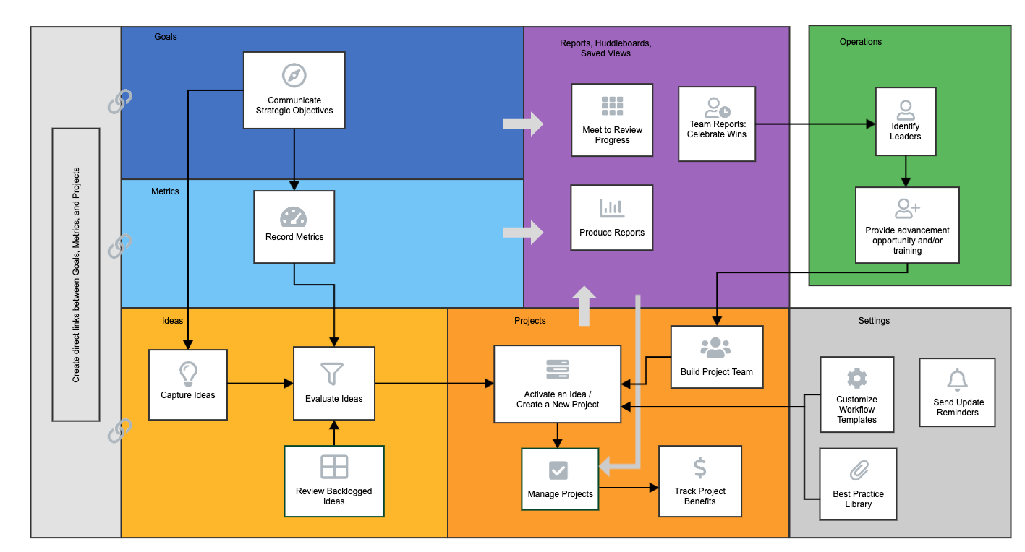
Jobs-to-be-done
Notes:
The Jobs-to-be-Done in KPI Fire start with communicating a strategic objective by creating company goals. In order to measure the progress of those goals we identify and track key performance metrics (KPIs). When establishing a plan of action for executing change, start with collecting ideas and out of those evaluate which to activate into projects based on the effort vs impact matrix. Projects can be created from scratch or built with premade workflow templates. Inside a project teams, tasks, and project benefits will be managed and recorded.
To keep goals, metrics, and projects inline with one another, create direct links between each element.
Regularly schedule meetings to review progress, produce reports, and celebrate wins.
This feeds back into a continuous cycle where best practices can be established, employees are recognized, and improvement projects can make an impact.

Slide 10




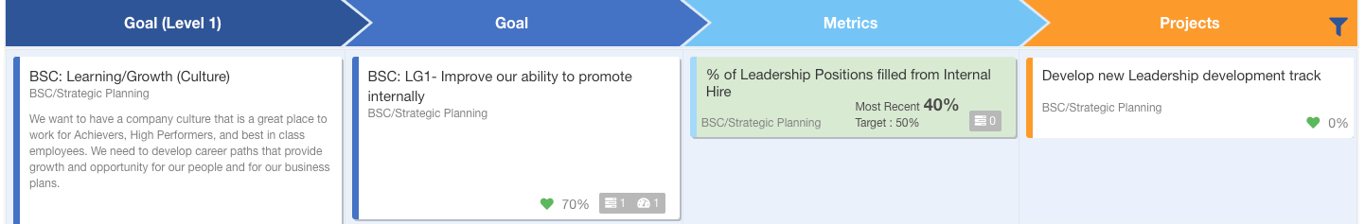
Colors and Icons
Goals: Dark Blue, compass icon
Metrics: Light Blue, meter icon
Projects: Orange, bars icon
(Linked Goals, Metrics, & Projects)
Notes:
When navigating KPI Fire, colors and icons are used intentionally to help identify goals, metrics, and projects.

Slide 11
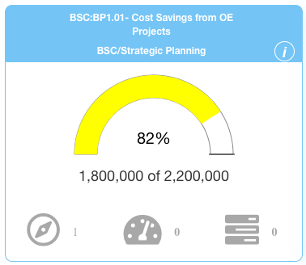

Red/ Yellow/ Green
Universal meaning in app:
  Red = Needs Attention
  Yellow = At Risk
  Green = Healthy, On-Target
Notes:
Red, Yellow, and Green are colors reserved to indicate the status of a goal, metric, or project.
Red = Needs Attention
Yellow = At Risk, may need attention
Green = Healthy, On-Target
Possibly add grid view image with r/y/g metrics in one place

Slide 12
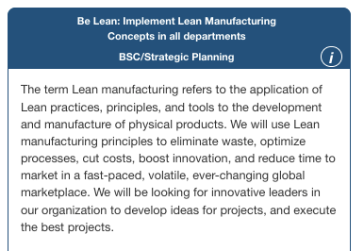
Goals
42% of workers across every gender, department, and age group say having unclear goals is their top source of stress. ^{[1]}
A broad or specific statement of strategic direction.
Fewer goals, more projects
Notes:
“42% of workers across every gender, department, and age group say having unclear goals is their top source of stress.” Establish strategic direction for all levels of employees by setting company goals. It can be broad or specific, but the practice should be to keep goals focused and at a minimum and create more projects in order to meet those objectives.
Replace bowling screenshot
Additional Resources:
Goal review: https://www.kpifire.com/blog/how-often-to-review-goals/
Balanced Scorecard: https://www.kpifire.com/blog/balanced-scorecard-example/
X-Matrix Dashboard: https://www.kpifire.com/blog/x-matrix-dashboard/
BSC Template:https://www.kpifire.com/blog/balanced-scorecard-template/
SMART Goals: https://www.kpifire.com/smart-goals/
Unclear Goals: https://www.kpifire.com/strategic-planning/the-42-problem-unclear-goals-are-the-top-source-of-stress-in-peoples-work-lives/
[1] Study: The Scoop on Stress – https://www.comparably.com/blog/having-unclear-goals-is-a-big-problem-for-many/

Slide 13
Metrics
Data is the voice of the process.
Metrics are tracked and analyzed to measure the results of a project and the progress of a goal.
A metric is something that can be measured. Determine which Key Performance Indicators (KPIs) you will use to measure the success of your business.
The primary objective of a project is to move a metric from x to y.
Notes:
How can we tell we are making progress on our goals? Well, data is the voice of the process, so we must identify and track key metrics (aka Key Performance Indicators KPIs). When managing a project, the primary objective is to move a metric from x to y, which shows improvement.
Additional Resouces:
KPIs: https://www.kpifire.com/continuous-improvement/kpi-key-performance-indicators/
Hoshin Kanri: https://www.kpifire.com/hoshin-kanri-steps/
Setting Up Metrics: https://www.kpifire.com/blog/setting-up-metrics-in-kpi-fire/

Slide 14
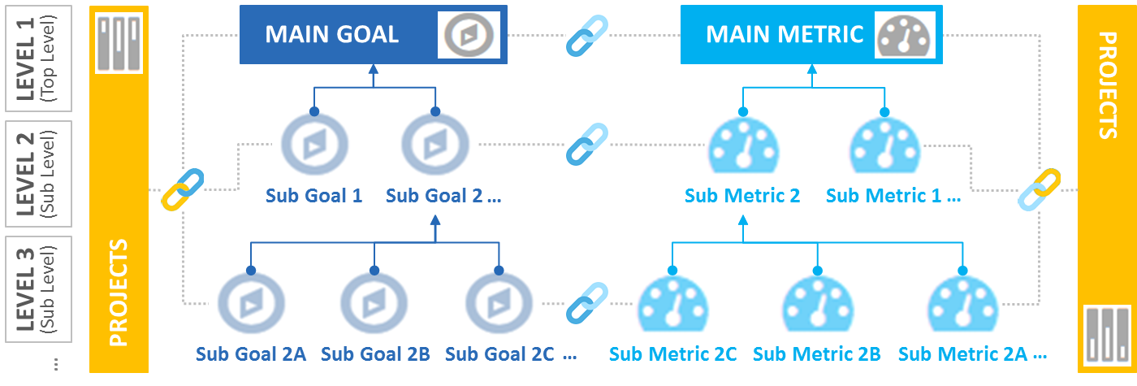
Linking
Create direct links from goals to corresponding projects and metrics
There is no limit or required amount of linking
Notes:
Create direct relationships between corresponding goals, metrics, and projects.
Linking help:
Best Practice: Link from Parent to Child,.
Use the “Action” button to link or unlink.

Slide 15
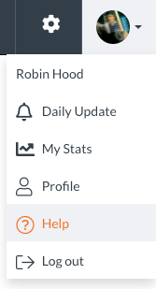

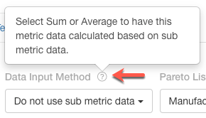
How to Find Help
User dropdown: Help
  Page directs to blog and video resources: https://www.kpifire.com/kpifire-tutorials/
In-app help tips located in top-right corners of pages and tabs:
  Link to blogs and videos
Hover over non-linking “?” icons for additional information
Local Admin:
  1st Point of contact for support: <Name & contact info>
Notes:
Each Region should have at least 1 person who has received some additional training.
Please go to that person for immediate, local support.
Additional resources are available in-app.

Slide 16
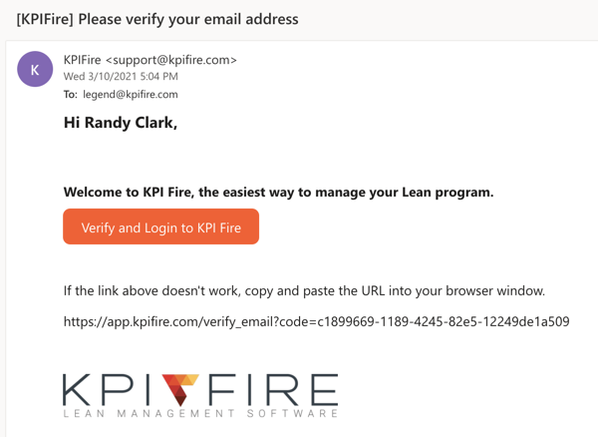
Login
https://app.kpifire.com/
Please look for an email from KPI Fire.
You MUST click the link in this first email to activate your account.
Note: using the forgot password link may not work if you do not click the link in the initial invite.
Notes:
Take this time to ask who is already logged in to the app, who needs help or an additional invite?
Troubleshooting:
Who is local admin (to help with access issues):
<user name>

Slide 17
Get Started - Creating a project
What is a Project
Types of Projects
Project Status (Idea, Active, Control, Complete)
Project Team Roles (Leader, Sponsor)
Project Workflows (DMAIC, PDCA, PMBOK, QW,)
Project Tasks & Task Groups
Project Benefits
Project Review

Slide 18
A goal without a plan is just a wish.
A goal with a plan is a project.

Slide 19
What is a Project?
A temporary endeavor designed to achieve a specific outcome.
  “For the strategy to become a reality, it must be converted into the packets of work we call projects. Projects are the temporary initiatives that companies put into place alongside their ongoing operations to achieve specific goals. They are clearly defined packages of work bound by deadlines and endowed with resources including budgets, people and facilities.” - Executing your Strategy. Morgan, Levitt, Malek
  “Any temporary endeavor with a definite beginning and end.” – Project Management Institute
  “Anything that requires more than 2 tasks to complete.” – David Allen, Productivity Author, Getting Things Done (GDI)

Slide 20
Which Projects Belong in KPI Fire?
Any project that meets the following criteria should be added to KPI Fire:
  <Company Specific>
When do we combine projects?
When do we split projects?
When should you NOT create a project?
Project Examples:
  Strategic Projects, BSC Projects
  Capital Projects
  Process Improvement Projects
  Managing Daily Improvements
Notes:
A specific set of actions taken with the purpose of improving a Key Performance Metric.
<Help the user to understand what type of projects they will be tracking in KPI Fire>
Is this project included on the annual strategic plan
Is this project a corrective action?
Is this project a process improvement that needs to be communicated?
Do you want to recognize or celebrate the team involved in this project?
<facilitate discussion here. get examples of which ones will/won’t be included.>

Slide 21


Which Projects Belong in KPI Fire?
Key Criteria: Project must be a specific set of actions to improve a KPI.
Type of Project | Yes | No
Process Improvement Projects
Strategic Projects
Balanced Scorecard
Capital Projects
Research & Development
Product/ Service Delivery
Personal Projects (ex Build a Tree House)
Notes:
A specific set of actions taken with the purpose of improving a Key Performance Metric.
KPI Fire is specifically designed for Process Improvement Projects. We have workflows to support various types or Process Improvement methodologies. You can also create your own workflows for other types or projects such as Capital projects, R&D, Service deliver etc. It is important to set clear expectations for the users in a given organization about which type of projects they should be putting in.
<facilitate discussion here. get examples of which ones will/won’t be included based on the specific company.>

Slide 22

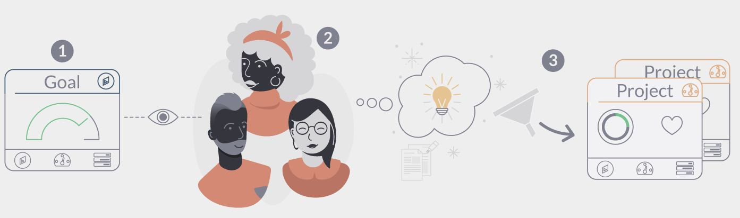

Activate Ideas into Projects
1. Make Company Objectives Visible to All
2. Collect Ideas from All Levels
3. Turn the Best Ideas Into Projects
Notes:
Make Company Objective visible to entire company. All levels of employees should be welcomed to share their improvement ideas. Use the new idea submission form to collect ideas and then evaluate them in the Idea Funnel.
Schedule regular meetings with your team to review and prioritize those ideas. For each idea, give a numerical rating for effort and impact. This will help you prioritize ideas and decide which ideas to active into projects.
Can also solicit goal specific ideas with the use of the external idea form.
From ideas we select and create projects.
External idea Submission Form: https://www.kpifire.com/blog/external-idea-submission-form/
Collecting Ideas:
https://www.kpifire.com/blog/employee-suggestion-program/
https://www.kpifire.com/blog/share-more-improvement-ideas/
https://www.kpifire.com/idea-capture-tools/
Idea Funnel: https://youtu.be/xiRe0IKoU9s

Slide 23
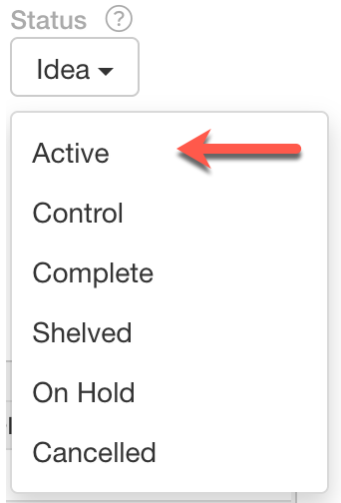
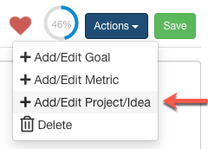
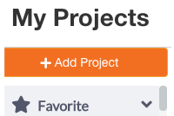

How to Create a Project
Activate an idea
Create a new project linked from a goal, metric, or project (actions dropdown)
Create from project views
Notes:
Multiple ways to start a project from
Activating an idea
Create a projects directly from and goal, metric, or project and link them in the process
From scratch via any project view

Slide 24
Project Naming
Use a descriptive name that can help avoid redundancy. If the project is likely to happen again, use a name that makes it easy to identify such as adding the month & year to the project name.
Bad Project Name | Good Project Name
Carousel | Vertical Carousel & Software implementation MN
Notes:
When naming a project it is important to be descriptive yet concise. Project Naming is a key skill. Avoid names that are too short, or potentially duplicate with other areas.

Slide 25
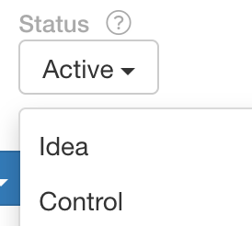
Project Status
Standard project status flow:
Stage | Description
Idea | Not an active project
Active | Active project, work in progress
Control | Main project work is complete, now tracking project benefits
Complete | No work in progress, benefits have been collected.
Shelved | Moves back to the Idea Funnel
On Hold | Active project which has hit a delay and is not moving forward
Cancelled | A project that was activated and then abandoned. Some tasks may remain incomplete.
Notes:
Standard flow of a project status: Idea → Active → Control → Complete
KPI Fire specifically separates Ideas in the Idea funnel from Projects.
Projects in Active, Control, Complete may be found in the Project List view.
You can add the Status column in Project list view for further filtering.

Slide 26
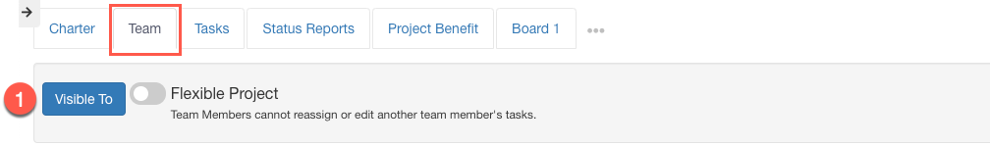
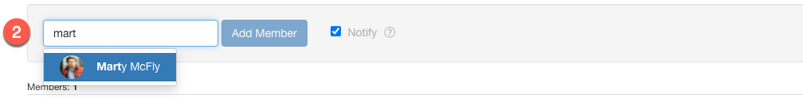

Team / Stakeholders
Determine who the project is visible to and if it should be flexible to team members editing tasks.
2. Add users to the team, check Notify to email the newly added member. If team member is not already user in app, then Invite a User.
Notes:
https://www.kpifire.com/blog/project-user-roles/

Slide 27
Team / Stakeholders
3. Assign user roles within the project.
Team Role | Description
Project Leader | Only 1 per project, the project owner. <company specific definitions>
Sponsor | Only 1 per project, typically, an executive who owns the budget or department that the project is being completed in. <company specific definitions>
Champion | Same permissions as a Sponsor <company specific definitions>
Member | Person who is completing tasks in project <company specific definitions>
Notes:
For more information on role and license permissions within projects:
KPI Fire User License Types: https://kpifire.com/kpi-blog/kpi-fire-user-license-types/
Project User Roles: https://kpifire.com/blog/project-user-roles/
<Company should set their own role specifications based on their own internal structure and way of operating>

Slide 28
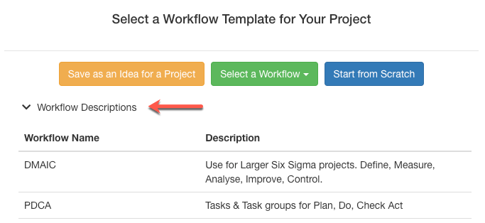
Project Workflows
Workflows are templates with specific sets of task groups and tasks. Available workflows are configured by KPI Fire Admins.
Assign workflows to projects with preset charter fields, task groups, and tasks.

Slide 29
Workflow Examples
Workflows are made available to users by admin configurations
Workflow | Description
DMAIC | Process Improvement following the Define, Measure, Analyze, Improve, Control stages.
Just Do it | Simplified Process Improvement work
PMBOK Standard | Project Management Body of Knowledge standards for Initiate, Planning, Execution, Monitor & Control, Close
PDCA | Plan, Do, Check, Act
Default | Anything else, or where a “start from scratch” template is selected.
Notes:
<Customize table specific to which workflows a company uses, consider using a screenshot from the workflow settings tab that includes the workflow name and description of each>

Slide 30
Project Charter
The project charter summarizes the work of the project.
Add each field as a tile on the charter
Field Name | Description
Problem/Opportunity Statement | A brief statement of the problem and/or opportunity that this project will address.
Goal Statement | What is the overall objective of this project, or Target Condition.
Project Scope | What is specifically included, what is specifically excluded from the scope of this project.
Linked Goals | If this project is linked to any Strategic Goals, it can be linked here.
Linked Metrics | If this project is designed to move one of your key metrics, link it here.
Before Photo/After Photo | For process improvement work, take a picture of the before and after.
Dates | Indicate the planned start & end dates

Slide 31
Problem/ Opportunity Statement
Explain the issue or circumstances that need to be improved upon. Identify the where the pain is coming from and if possible, quantify it.
Examples: 10% of products are being delivered with damaged packaging. The retail customer will not display damaged packaging. This results in unhappy customers who have less inventory than expected and loss of sales for us.

Slide 32
Goal Statement/ Desired Outcome
Identifies the metric to be impacted as well as the direction and amount of the change.
  Goal format: Direction (+/-) of Metric from X to Y by when.
  <Increase/decrease> + <metric name> + from <x> to <y> by <when>
Establish clear goals that are aligned with company values.
SMART Goal: Specific, Measurable, Actionable, Realistic and Time Bound.
Example: Reduce the amount of packaging being damaged from 10% of product to zero by the end of the month. Improve the packaging to shipping process.

Slide 33
Project Scope
Explain which processes you are going to work on and which processes you will NOT work on as part of this project
Example: In-scope- the handling of packaging material in storage, when being assembled to product, shipped to retailers. Out-of-scope- supplier of packaging material, packaging of product after being delivered to retailer.

Slide 34
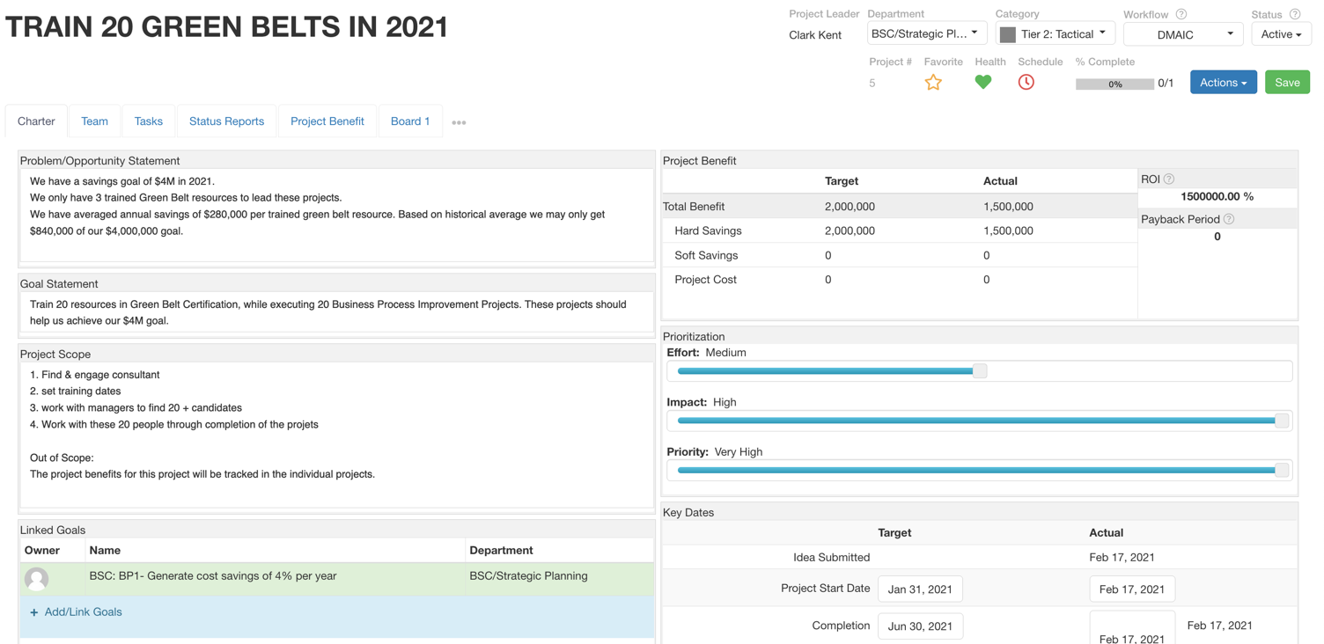
Project Charter

Slide 35



Project Health
Project Health is manually updated by the project Leader.
Health | Description
Green | Project is on-time, on-budget, & no issues to be concerned with <company specific criteria>
Yellow | Project has some issues or risks, that may affect the timeline, budget, or deliverables. Stakeholders should be aware. <company specific criteria>
Red | Project has a problem that may require outside intervention from a Sponsor to get back on track. <company specific criteria>
Notes:
<Company should set their own requirements for each health standards>

Slide 36



Project Schedule
Project is automatically updated based on if tasks are completed on schedule or are past due.
Health | Description
Green | No task is overdue, project is on schedule.
Yellow | Project has 1+ tasks overdue.
Red | Project is past the scheduled completion date indicated on charter tab dates.

Slide 37
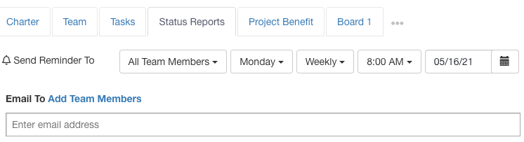
Status Reports
Send a reminder to submit a status report that will appear on the user’s Daily Update page.
Best Practices:
  Schedule a reminder for a weekly status update for the project leader
  Submit a report each time a project review is conducted
Notes:
Additional Resources:
Project status reports: https://www.kpifire.com/blog/project-status-reports/
How to Get Better Project Status Reports - https://www.kpifire.com/project-management/how-to-get-better-project-status-reports/

Slide 38
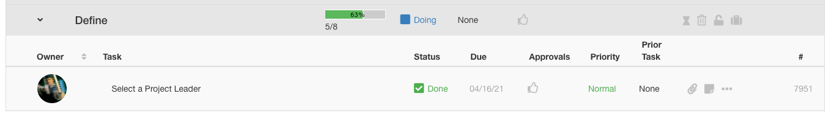
Project Tasks
Task groups act as progress milestones
Task features:
  Owner: Member of team task assigned to
  Task Name: Basic description of task
  Status: To Do, Doing, Done
  Due (Date): None or manually set date
  Approvals: None required or assign 1+ approvers
  Priority: High, normal, low
  Attachments: Linked files
  Notes: Task details
Notes:
Demonstrate:
-Task Groups
-Creating tasks, sub tasks
-Assign owner
-change status
-start & due date
-approvals
-has attachment, has note
-share a task link url.

Slide 39
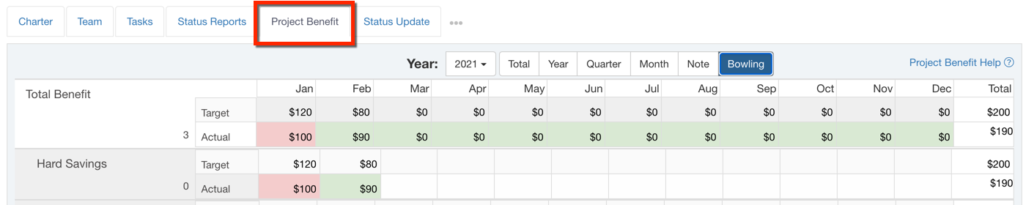
Project Benefits
For tracking project financial impact.
Project benefits accounts are configured in the company settings
  Examples: Total Benefit, Hard Savings, Soft Savings, Costs
Notes:
Track the hard and soft savings from your improvement projects. Celebrating successes engages your project team and creates more success.
https://www.kpifire.com/product-updates/total-project-benefit/

Slide 40
Hard Savings vs. Soft Savings
Hard Savings | Soft Savings
Direct financial Impact on Balance Sheet or Income Statement. | Indirect financial impact, or longer-term impact than is required to classify as Hard Savings.
Clear cause & effect relationship between process metric change and financial impact. | Less direct cause & effect relationship between process metric change and financial impact.
Can be audited or verified
Can be measured in Dollars

Slide 41
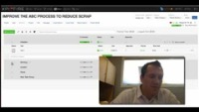
Managing Projects in KPI Fire - Demo
Notes:
Managing Projects in KPI Fire: https://youtu.be/w6tqJUroe4U

Slide 42
Project Review
Preparing for a review by updating:
  Charter fields, files attached, tasks, project benefits, metrics
Conducting a review
  Meet with stakeholders and team members
  Review plan, progress, blockers, at-risk metrics
  Uncover problems and discuss solutions for moving the project forward
  Submit a status report
Types of Reviews:
  Milestones: Stage Gate Reviews
  Time-based: Weekly/ Bi-Weekly/ Monthly Business Review
Notes:
Use Stage Gate Reviews for reference
How to flag something for review
milestone reviews not necessarily helpful in pushing a project along
Charter → tasks --> status Report

Slide 43
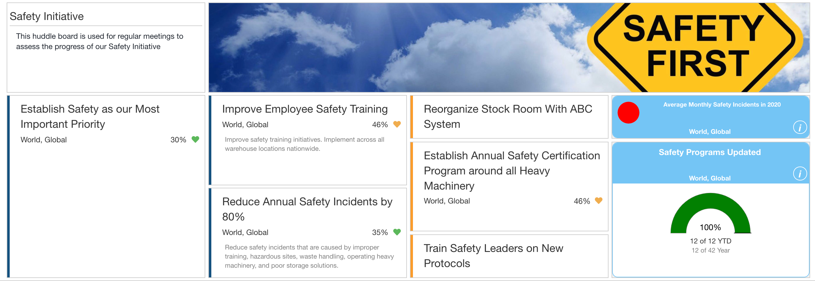
Huddleboard
Huddleboards are a virtual meeting place to review and update project development, track metrics, and manage goals.
Build layouts by selecting tile types and positioning them to their liking.
Department, team, and visibility settings to easily control access and the ability to edit.
Notes:
https://www.kpifire.com/blog/how-to-use-a-huddle-board/
https://www.kpifire.com/blog/huddleboards-in-kpi-fire/
https://www.kpifire.com/blog/custom-dashboards/

Slide 44
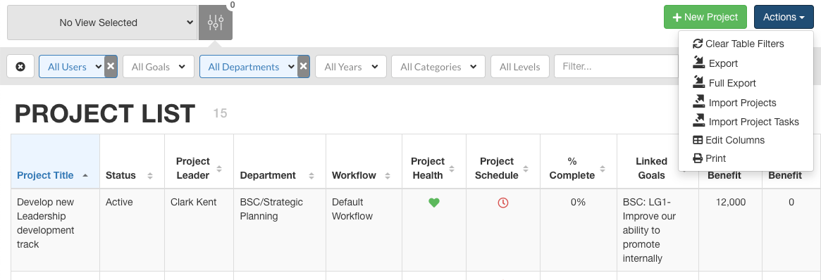
Project List View
Actions → edit columns to customize table
Save View with global filters set
Notes:
Saved View Help:
Filtering - Don’t see records?
Try Clear Filters & re-select criteria
Try Filter by Department “or” filter by Goal.
Ask your local admin to create a “saved view”
Check the ”visible to” settings on Team tab.

Slide 45
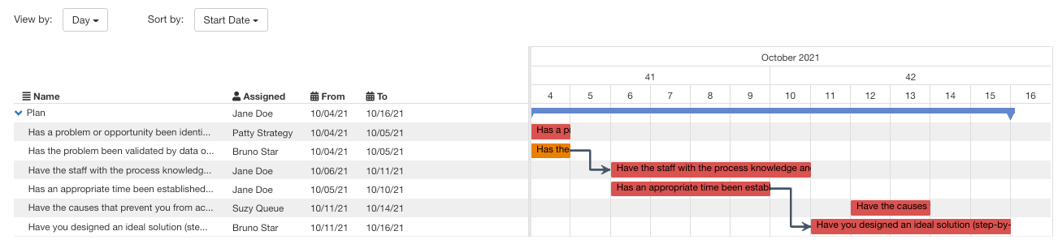
Timeline View
Project Timeline is a Gantt view of project tasks
Drag/drop to edit start and end dates
Toggle view and sort options

Slide 46
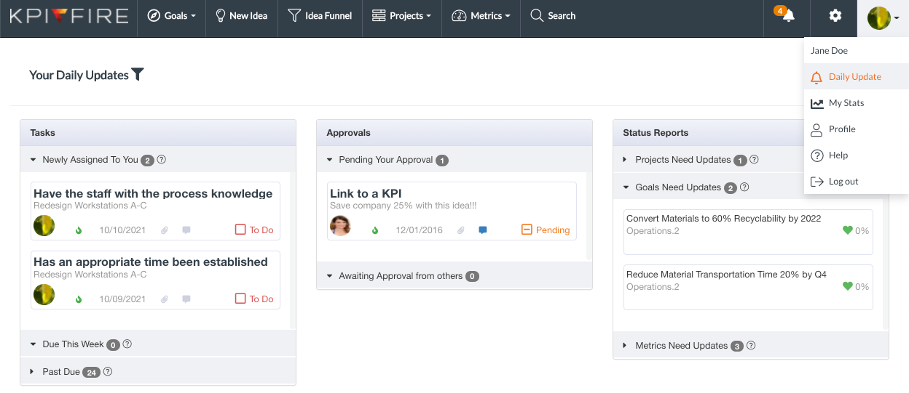
Daily Updates
Custom to each user, stay up-to-date with tasks, approvals, and status reports that require action to be taken.

Slide 47
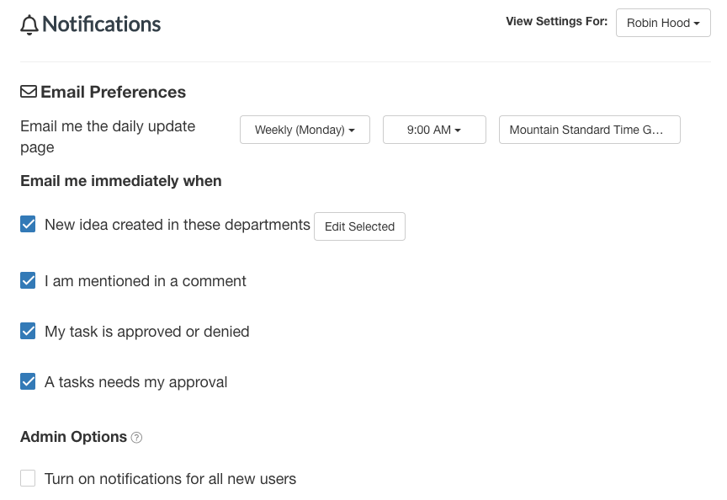
Notifications
Set email notification settings for individual users
Admin- can toggle default new user settings to all notifications on

Slide 48
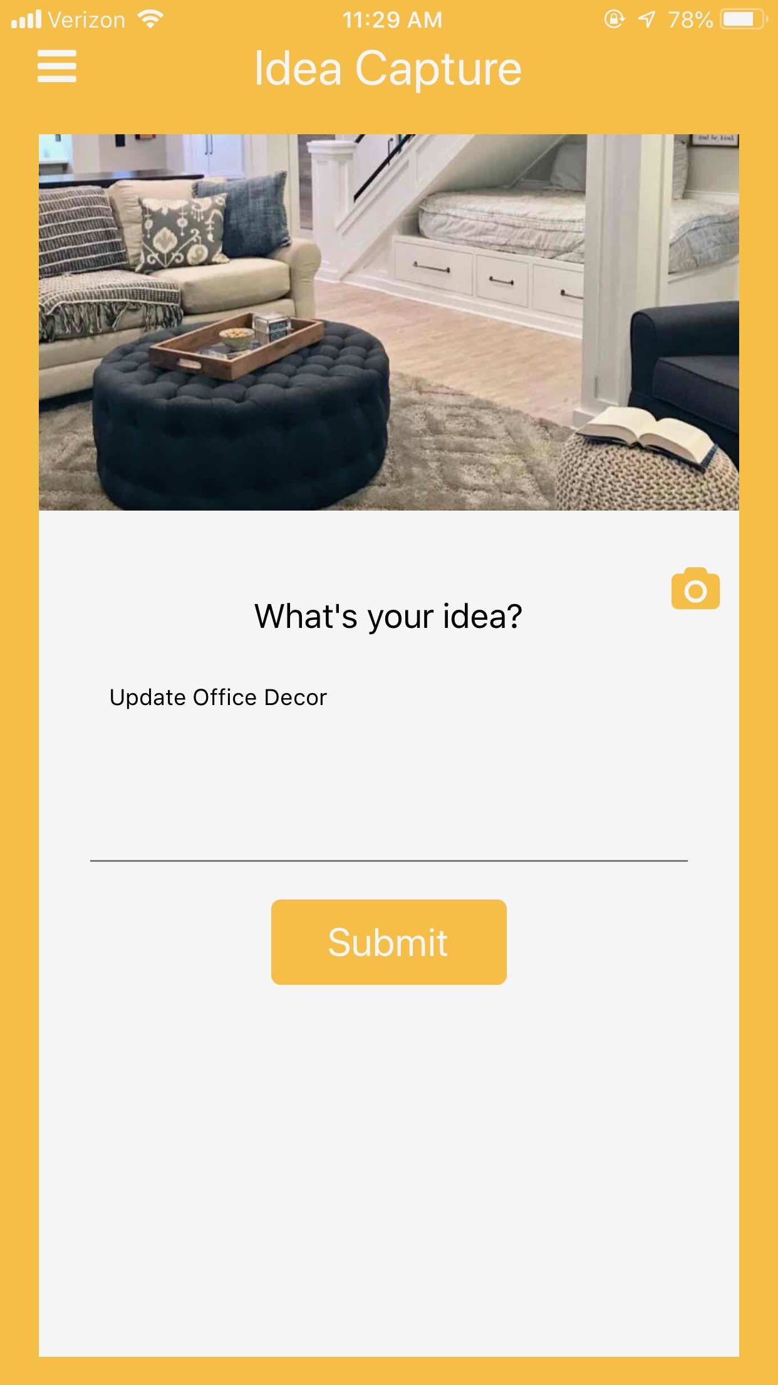
KPI Fire Mobile App
Available for iOS & Android
Capture ideas
  Submit with photos
Simplified interface for project management
  project list
  project details
  tasks
Notes:
https://www.kpifire.com/blog/mobile-app/

Slide 49
Additional Training for Local Admins
User Access:
  Permissions, License Types, adding/removing users
  Reset user password, change department/license types,
Saved Views & Filters
Problem | Trouble-shooting
I can’t login | Check user invite status, resend, set to active, reset password.
I don’t see the right tabs, | Check License type & Department
I don’t see the right data. I can’t edit the data | Check user department, and record access (Team Tab, Visible to button)

