Slide 1
Using the New Idea Poster Templates
In KPI Fire
Soliciting ideas from employees who are closest to the work is one of the best ways to ensure continuous improvement, and working on issues that solve REAL problems.
Purpose of this document:
-Make it easy for KPI Fire customers to create customized “New Idea” posters that they can use in their organizations.
-New Idea posters contain a QR code that can access the “new idea” form from any modern mobile device, making it super easy to unlock the ideas of your employees.

Slide 2
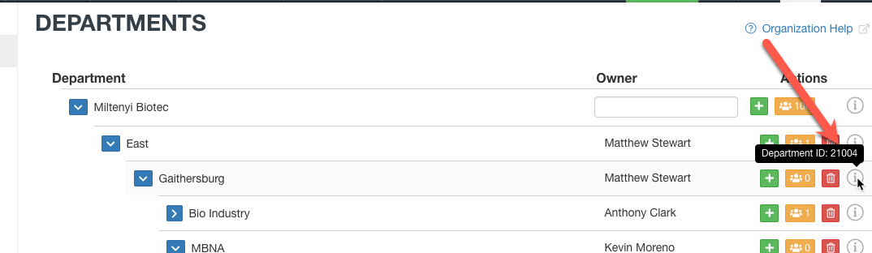
Getting Started with KPI Fire Idea Funnel Posters
To help you drive engagement and surface meaningful ideas from across your organization, here's a simple guide on how to use the KPI Fire Idea Funnel Posters effectively.
1. Purpose of the Posters
These posters are designed to make it easy for your team to:
Spot opportunities for improvement
Share their ideas quickly via a QR code
Improve processes, safety, quality, or compliance across departments
Each poster contains a QR code that links directly to a pre-filtered idea submission form based on department or goal.
2. How to Create or Customize Posters
Each department should have a unique QR code that directs submissions to their specific idea funnel in KPI Fire.
To generate the correct link, you simply append the department ID to the idea creation URL:
https://app.kpifire.com/#/305/goal/idea-creation?department_id=2004
Replace XXXX with the department’s ID (e.g., 21002 for San Diego).
You can use a free QR code generator to convert this URL into a QR code and place it onto your poster. One option:
Few Ways to Generate QR Code Using JavaScript | by Sagar Shrestha | Geek Culture | Medium
3. Suggested Use
Print and post the posters in common areas: break rooms, production floors, or near workstations.
Encourage teams to scan and submit on the go—no login required for most external forms.
Reinforce that the ideas are reviewed and managed by the US PMO/BPM team to ensure visibility and action.

Slide 3



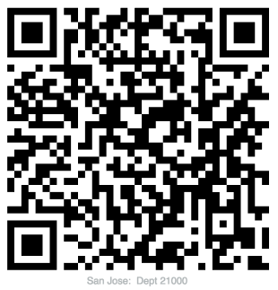
Share your Ideas &
MAKE AN IMPACT
Improve
Safety
Enhance
Quality
Reduce
Waste
Optimize
Processes
Ensure
Compliance
Scan the QR code and submit your ideas!
Spot it.
Share it.
Improve it.
Ideas Managed by:
UC CI Team

Slide 4
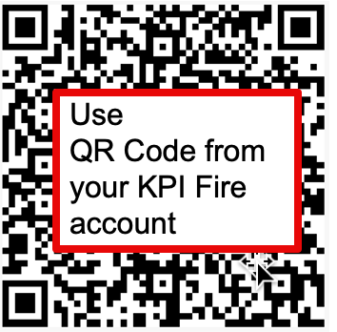
Share your Ideas &
MAKE AN IMPACT
Editable
Template
Improve
Safety
Enhance
Quality
Reduce
Waste
Optimize
Processes
Ensure
Compliance
Scan the QR code and submit your ideas!
Spot it.
Share it.
Improve it.
Ideas Managed by:
US PMO / BPM Team

Slide 5
